Slide 1

Moshbots
5SD806 - AI Programming
Uppsala University
Teemu Laiho

Slide 2
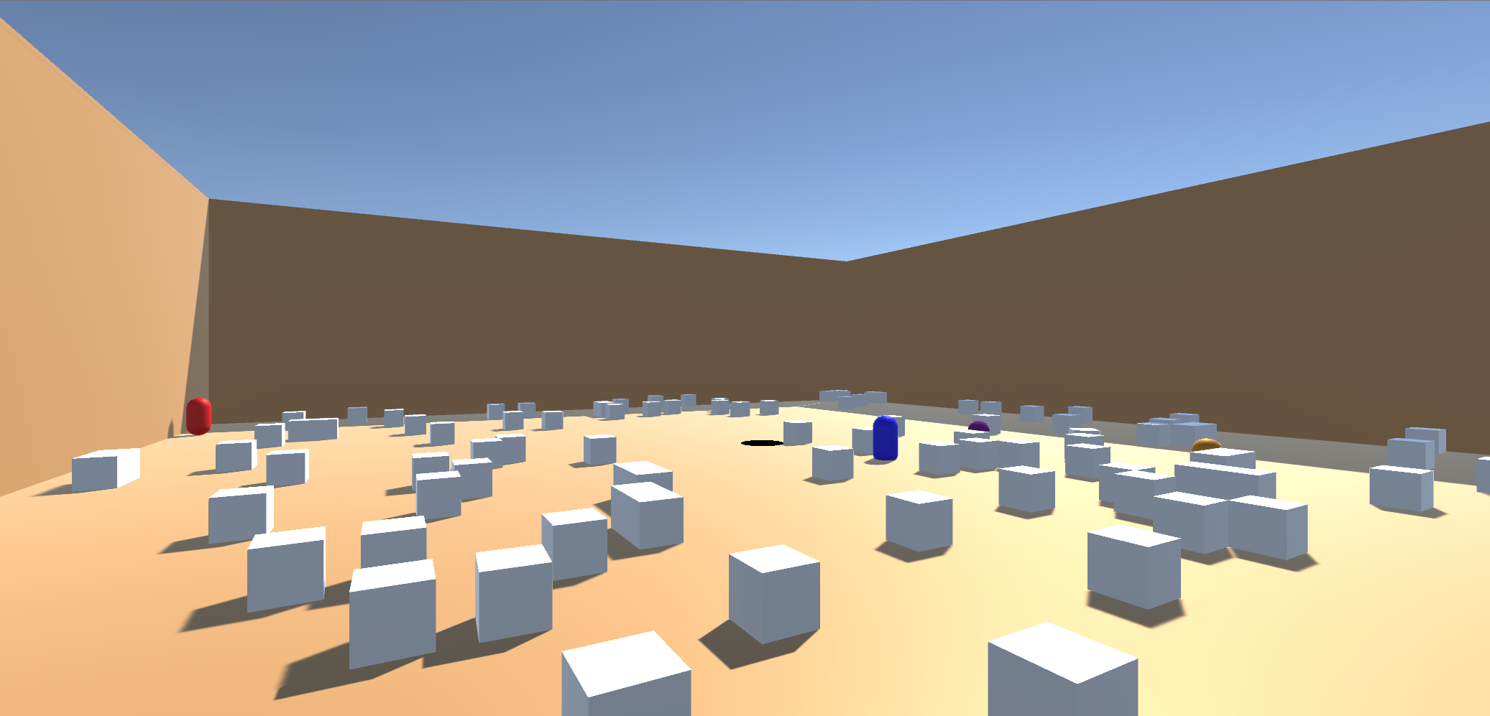
Arena Madness

Slide 3
Different Objects
Agents
Powerups
Goal
Ball

Slide 4
Roles
Lead Agent | Support Agent | Offense Agent
Goes After Ball | Supports Lead With Ball | Attacks Opponents
Attacks Opponent | Attacks Lead’s Chasers
Fetches Powerups

Slide 5
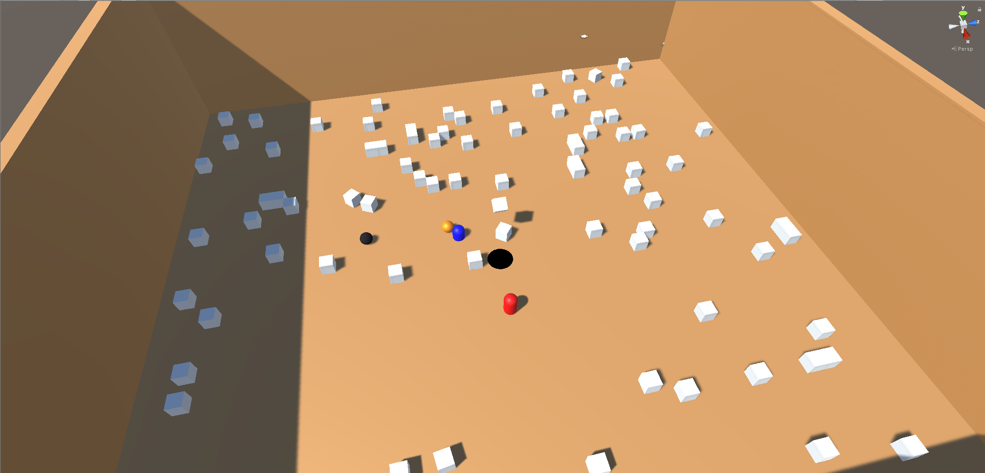
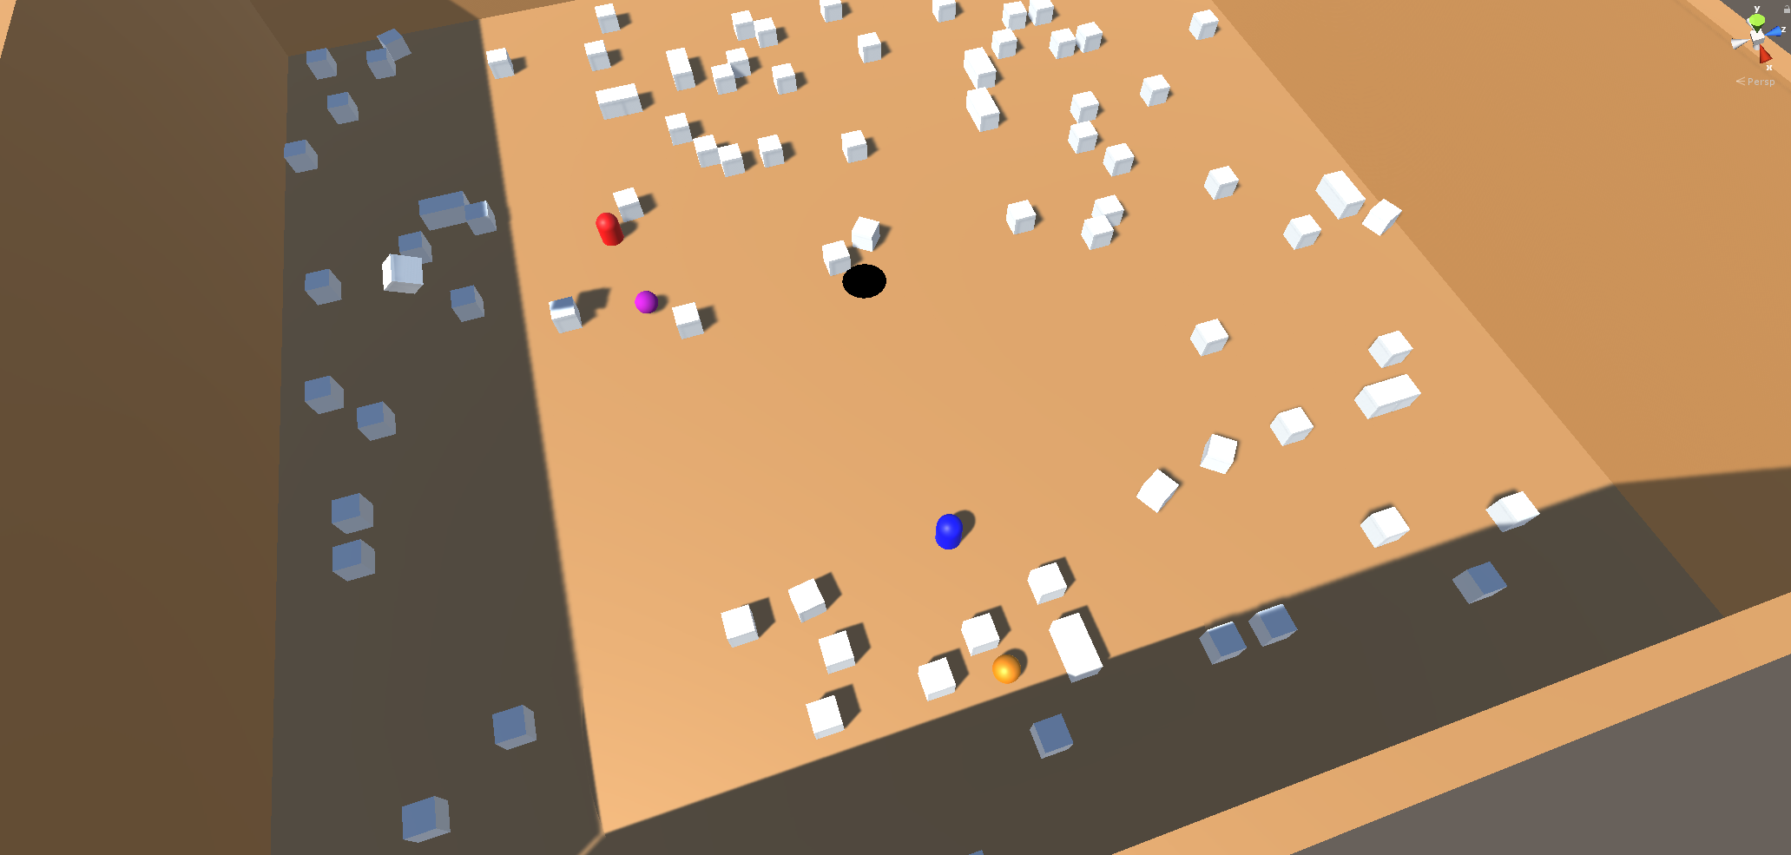
Example Cases (Let’s Follow Red Lead)
Chase after Opponent with ball
Go for Powerup, Ball too far away

Slide 6
Lead Agent
Root [SELECTOR]
Health Branch [SELECTOR]
Ball Branch
[SELECTOR]
Powerup Branch [SELECTOR]
Is Health Below 25%?
[SEQUENCER]
Do I Have Ball?
[SEQUENCER]
Does Someone Else Have Ball? [SEQUENCER]
Is Ball Free?
[SEQUENCER]
Is Powerup Speed?
[SEQUENCER]
Is Powerup Kick?
[SEQUENCER]

Slide 7
Looking Deeper
Do I Have Ball?
[SEQUENCER]
Does Someone Else
Have Ball?
[SEQUENCER]
Is Ball Free?
[SEQUENCER]
Is Powerup Speed & Active?
[SEQUENCER]
Is Powerup Kick &
Active?
[SEQUENCER]
Is Health Below 25%?
[SEQUENCER]
Do I have Ball?
Is Ball Close Enough?
Is Ball Close Enough?
Is Powerup Close Enough?
Is Powerup Close Enough?
Is Health Above 25%?
Invert
Target Goal
Does Someone Else Have Ball?
Is Ball Free
Target Powerup
Target Powerup
Target Safe Area
Move Towards
Target Someone Else
Target Ball
Move Towards
Move Towards
Move Towards
Score Goal
Move Towards
Move Towards
Capture Powerup
Capture Powerup
Heal
Kick
Capture Ball

Slide 8
Behavior Tree Support Agent
Root [SELECTOR]
Defence Branch
[SELECTOR]
Does My Team Have Ball?
[SEQUENCER]
Defend Teammate
[SEQUENCER]

Slide 9
In Retrospect
Issue #1
- Lead Agent has too many roles.
- Could split attacking and fetching to different roles.
Issue #2
- Checking distance between objects.
- First was Vector3.Distance(Vec3 a, Vec3 b);
- Powerups Messed up Distance Calculation.
- Distance itself was not relevant, rather how long to reach target.
- Result:
(Distance / Speed) -> Uniform Comparison

Slide 10
Next Steps
- Implement Teams
- Add Playable Character?

Slide 11
Course Learnings
- Sense / Decide / Act – Not Sure Yet - A* – RTS Gameplay (AoE II, here I come) - Behavior Trees
Add To Vertical Slice?
Code Structure! Unity! Dictionaries! BlackBoards!
gameManager { List<GameObjects> objects; List<Other>; List<Etc.>; } gameManager.Update() { for (List.Count) { objects.Update(); } }
(I realize this was Game Programming 1) lol

Slide 12
Thank You!
Teemu Laiho

Slide 13
Does My Team Have Ball?
[SEQUENCER]
Does The Other Team
Have Ball?
[SEQUENCER]
Is Ball Free?
[SEQUENCER]
Do I have Ball?
Is Ball Close Enough?
Is Ball Close Enough?
Target Goal
Does Someone Else Have Ball?
Is Ball Free
Move Towards
Target Someone Else
Target Ball
Score Goal
Move Towards
Move Towards
Kick
Capture Ball

